Slide 1
CO456 Web - most materials adapted from Moseley (2007), Chapter 4 -
Unit 4
CSS for styling layout and navigation

Slide 2
Positioning with CSS
The position of HTML elements flows and wraps in the order they are declared in the document.
CSS provides a means for breaking the normal HTML flow and to position elements out of order and more precisely.
Using CSS elements may be positioned and shaped as follows
ABSOLUTE-ly in a page
RELATIVE-ly to the normal flow within a page
In ‘depth’ using a z-index
By reshaping elements
By floating elements “left” or “right”

Slide 3
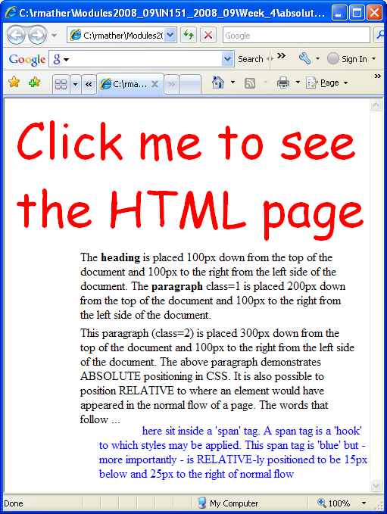
Positioning with CSS “Absolute” and “Relative”
Absolute positioning - in the example below
the <h1 >heading is placed 100px down and 100px from the left side.
paragraph 1 <p class=“1”> is placed 200px down and 100px from the left.
paragraph 2 <p class=“2”> is placed 300px down and 100px from the left.
Relative positioning – in the example below
some text is RELATIVE-ly positioned to be 15px below and 25px to the right of normal flow
Note – the <span> element is a 'hook' to which styles may be applied.
<html><head><style type="text/css">
h1 {position: absolute; top: 100px; left: 100px}
p.1 {position: absolute; top: 200px; left: 100px}
p.2 {position: absolute; top: 300px; left: 100px}
</style></head>
<body> <h1>An absolutely positioned heading here</h1>
<p class="1"> … some absolutely positioned text here … </p>
<p class="2"> … some absolutely positioned text here ...
<span style="position: relative; top: 15px; left: 25px; color:blue">
… and … some relatively positioned text here ...</span></p>
</body></html>

Slide 4
Positioning with CSS “z-index”
The z-index is a number that determines where an object is in a ‘vertical’ stack of elements
Higher z numbers place elements closer to the top of the stack
In this example a paragraph is placed at the bottom (z=0), an image over the paragraph (z=1) and the heading at z=2
Height and width properties may also be set (see the img.x style in source below)
Click on the image for the example and source (image courtesy of http://www.horton-szar.net/clipart/boats.php)

Slide 5
Positioning with CSS “clip”
Elements, especially images may be shaped by specifying clip coordinates
img.x {position: absolute; clip:rect (100px 300px 300px 100px)}
In this example the elephants are “clipped” from the larger image (click on image)
Another useful property is the “overflow” one which may be set using values
“visible” (expands an element so all contents fit - the default value)
“hidden” (hides contents that don’t fit inside the element)
“scroll” (adds scroll bars so the user may examine the content)

Slide 6
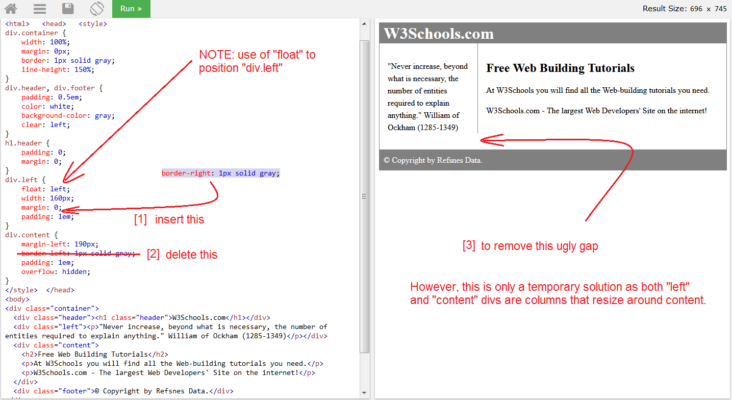
Positioning with CSS “Float”
Possible to impose relative positioning by floating elements so that other content flows around them
Float may have values “left” or “right”
Commonly used for images and for controlling layout with <div> elements
Problem – implementation
of float is inconsistent
across browsers
Click the image to visit
W3schools example

Slide 7
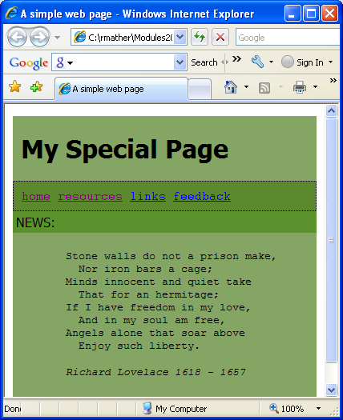
Positioning with CSS “<div>”
The intention of CSS => separate formatting and styling rules from content
Use of CSS and <div> (division) elements to independently position and style logical sections of pages is a very powerful way to impose structure and layout
Commonly used for images and for controlling layout with <div> elements
Generally base layouts on identifiers e.g.
CSS = #navigation{padding: 10px; border: 1px … background-color:#5c892e }
Implementation in <body> = <div id="navigation">
Problem – implementation of float is inconsistent
across browsers
Click the image to visit the example

Slide 8
Positioning with CSS Advanced Layouts and Navigation
Common practice is to nest all <div> elements inside a single “container”
Examples of nested elements may include separate <div> identifiers for “head”, “navigation”, “content”, “foot” panels.
Multiple column layouts may have additional identifiers, for example a three column layout may have “navigation”, “contentMain” and “contentRight”
Centre, float and height positioning of <divs> is problematic due to cross-browser incompatibilities
Many developers adopt special XML HTML “Quirks mode” to ensure backward compatibility across browsers e.g.
<!DOCTYPE HTML PUBLIC "-//W3C//DTD HTML 4.01 Transitional//EN" "http://www.w3.org/TR/html4/loose.dtd">
See comprehensive reference on http://en.wikipedia.org/wiki/Quirks_mode
… see later for an example …

Slide 9
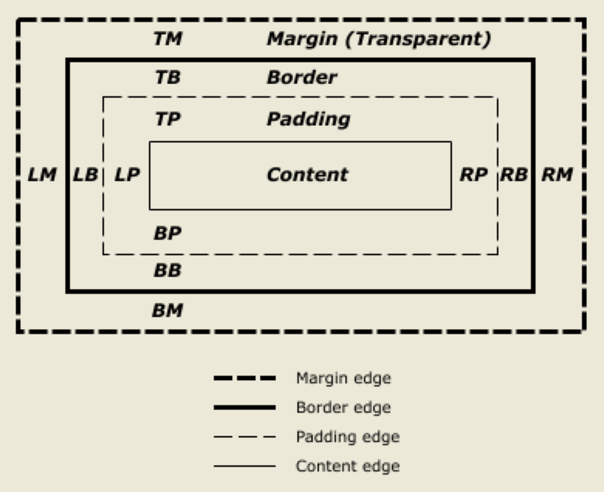
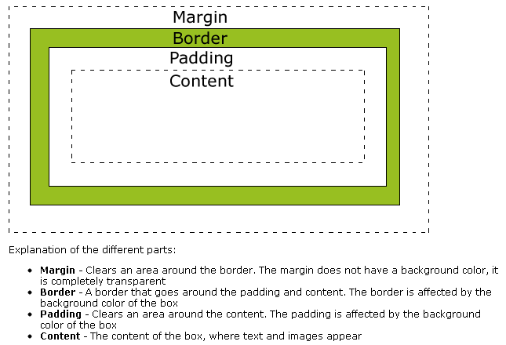
The Box Model (materials provided by W3C and W3Schools)
“Each box has a content area (e.g., text, an image, etc.) and optional surrounding padding, border, and margin areas; the size of each area is specified by properties defined below. The following diagram shows how these areas relate and the terminology used to refer to pieces of margin, border, and padding ... ” W3C (http://www.w3.org/TR/CSS2/box.html)
Suggest that for a better understanding of the box model visit W3Schools and read ...
http://www.w3schools.com/css/css_boxmodel.asp
... Then “try it” using their interactive frames here ...
http://www.w3schools.com/css/tryit.asp?filename=trycss_boxmodel_width

Slide 10
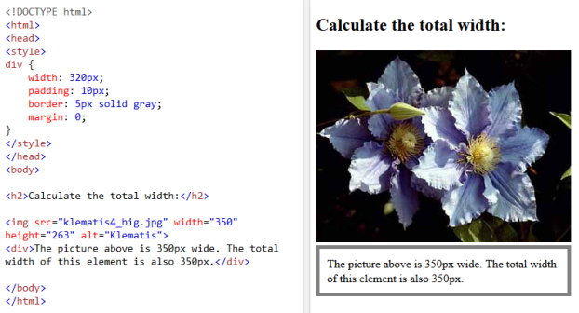
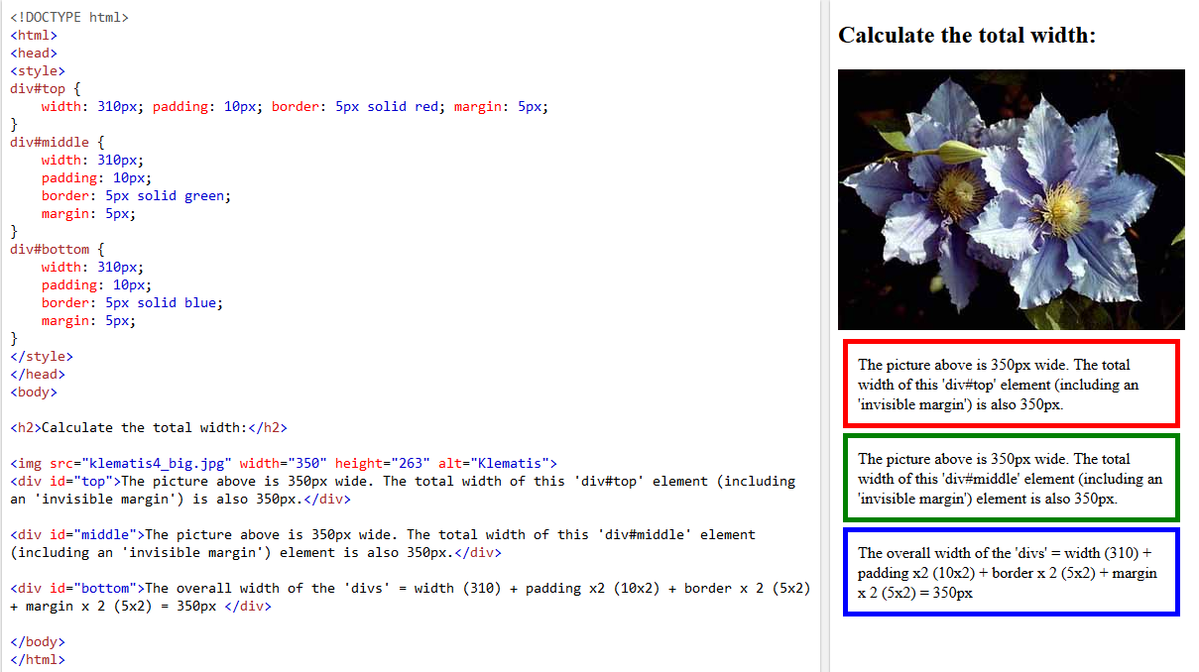
‘Try it out’ add more <div>s using ID selectors

Slide 11
Positioning with CSS Advanced Layouts and Navigation
Aim – “imageless” 3D button like navigation w/o bandwidth overhead
One ‘old’ solution – the humble HTML list – can modify borders, colours, rollover effects so that they have all the appearance of a button
Example here … do examine Mark Newhouse’s ‘buttons’!
HTML could be as follows – CSS does the rest!
<div id=“NavigationButtons">
<ul>
<li><a href="http://www.MySite/home"</a></li>
<li><a href="http://www.MySite/page1">Page 1</a></li>
<li><a href="http://www.MySite/page2">Page 2</a></li>
<li><a href="http://www.MySite/page3">Page 3</a></li>
</ul>
</div>

Slide 12
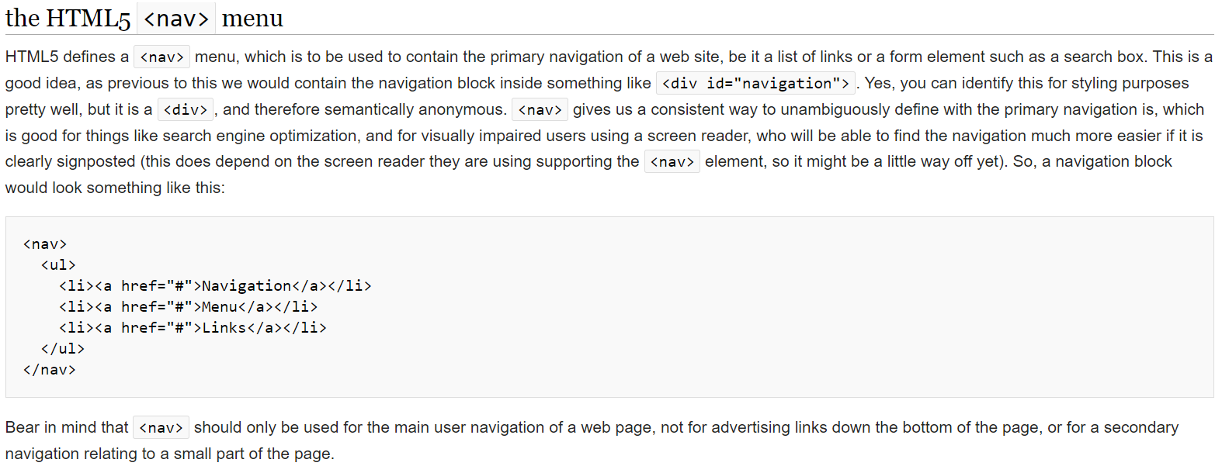
W3C approved <li> <nav>igation
W3C approve the use of <li> elements in HTML5
Providing these are used in the context of a <nav> menu
Creating multiple pages with navigation menus - W3C Wiki

Slide 13
Positioning with CSS Putting it all together - Advanced Layouts and Navigation
Possible to produce easily modifiable templates for layout and navigation
This example combines a 2 column header and footer layout with 3D CSS button navigation.
The layout is uses CSS identifiers to control div position
The main “container” <div> is set to 70% and centred by setting margin-left and margin-right properties to be equal using the 'auto’ value.
3D rollover button effects use CSS
border: 4px inset/outset properties
Investigate/modify the mechanism
by examining the HTML and CSS
For more on float problems and the
need to clear floats go to …
http://css-tricks.com/all-about-floats/

Slide 14
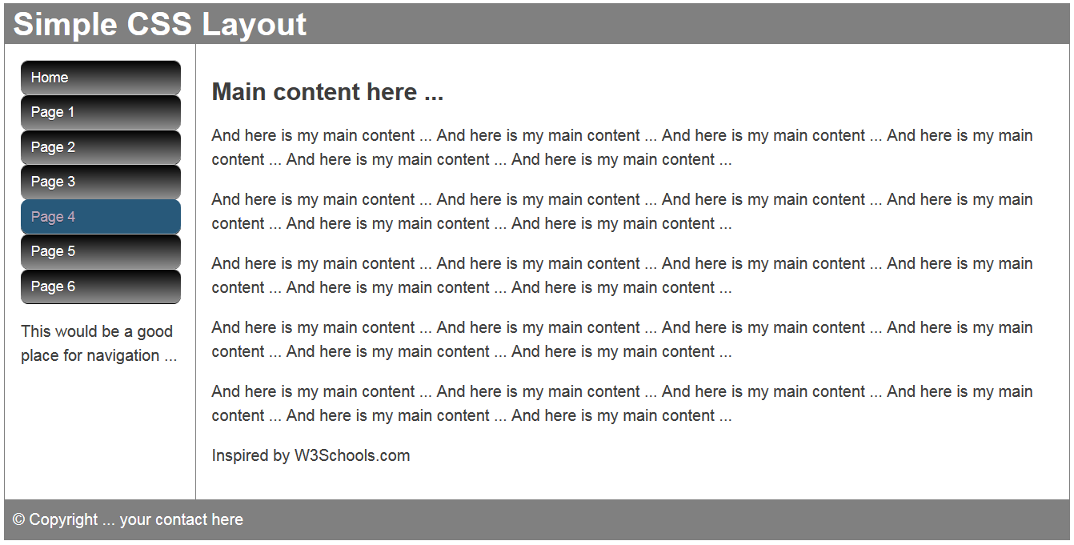
CSS3
CSS3 provides greater graphic control with features such as radius and gradient
Follow the hyperlink to the above and examine the CSS comments …

Slide 15
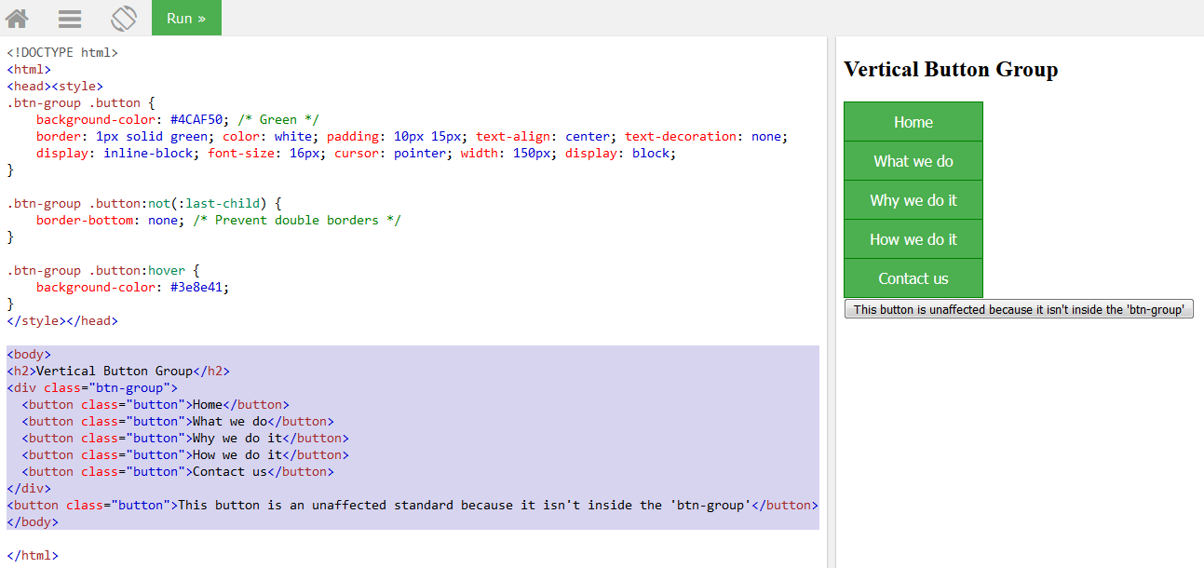
Now preferable to use <button> elements …
Examine the following … have a go at … https://www.w3schools.com/css/tryit.asp?filename=trycss_buttons_group_vertical

Slide 16
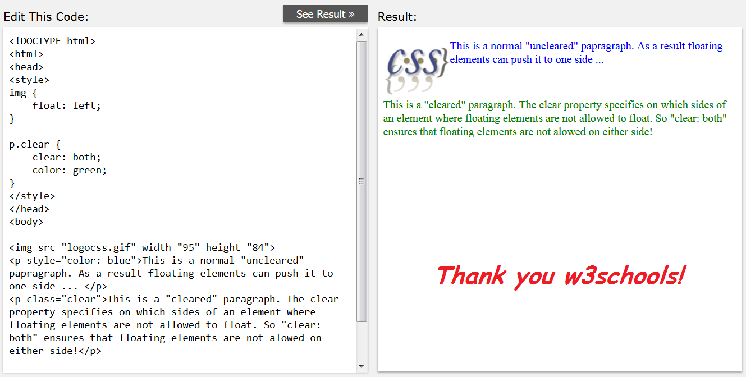
The importance of being clear

Slide 17
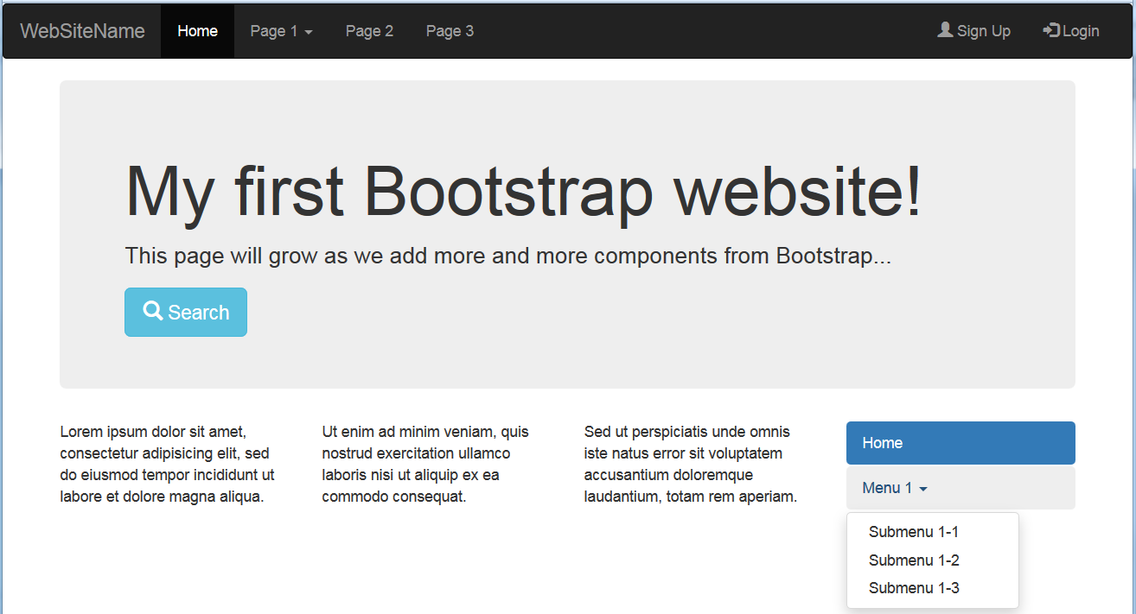
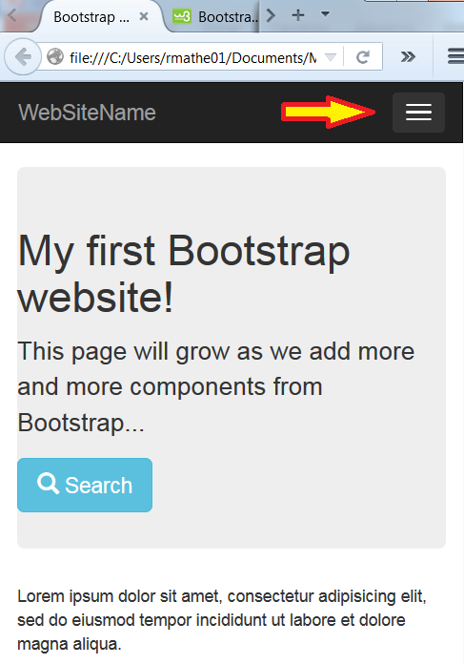
Framework layouts
Widely used to reduce cross-browser CSS inconsistency maintenance headaches!
JQuery, JQuery mobile and Bootstrap offer great layouts that are also mobile sensitive
These collapse navigation and automatically re-render other elements to fit screen or window size
Follow hyperlink to inspect link to frameworks …
Also explore W3Schools Bootstrap templates and themes …
… here … https://www.w3schools.com/bootstrap/bootstrap_templates.asp

Slide 18
References and sources
Create CSS buttons quickly here http://www.thesitewizard.com/wizards/css-menu-buttons.shtml or here http://css-tricks.com/examples/ButtonMaker/#
Learn about float problems and the need to “clear” floats http://css-tricks.com/all-about-floats/
Online book covering many aspects of design http://www.webstyleguide.com/
Mark Newhouse’s solutions to CSS navigation http://alistapart.com/article/taminglists
Ross Shannon on many CSS subjects including changing the look of browser scroll bars http://www.yourhtmlsource.com/stylesheets
Wikipedia on CSS http://en.wikipedia.org/wiki/Cascading_Style_Sheets
Nick Rigby on CSS dropdown menus http://www.alistapart.com/articles/horizdropdowns
Matthew James Taylor’s layouts and navigation http://matthewjamestaylor.com/blog/perfect-multi-column-liquid-layouts
W3C The Box Model http://www.w3.org/TR/CSS2/box.html
W3Schools The Box Model (and introduction to Bootstrap) http://www.w3schools.com/css/tryit.asp?filename=trycss_boxmodel_width
A nice progressive tutorial on layout http://learnlayout.com

